Slide 1
Chapter 9:
LAN Architecture & Protocols
Business Data Communications, 6e

Slide 2
Personal Computer LANs
Client/server communication
Shared resources
Peer-to-peer communication
Low cost is high priority

Slide 3
Backend &
Storage Area Networks
“Computer room networks”
High data rate
High-speed interface
Distributed access
Limited distance
Limited number of devices

Slide 4
Storage Area Networks (SAN)
Separate network to handle storage needs
Creates a shared storage facility
May include a variety of storage devices such as disks, CD arrays, tape libraries
Storage devices and servers are linked direcly to the network

Slide 5
High-Speed Office Networks
Increased processing and transfer requirements in many graphics-intensive applications now require significantly higher transfer rates
Decreased cost of storage space leads to program and file bloat, increased need for transfer capacity
Typical office LAN runs at 1-20mbps, high-speed alternatives run at 100+

Slide 6
Backbone Local Networks
Used instead of single-LAN strategy
Better reliability
Higher capacity
Lower cost

Slide 7
Tiered LANs
Cost of attachment to a LAN tends to increase with data rate
Alternative to connecting all devices is to have multiple tiers
Multiple advantages
  Higher reliability
  Greater capacity (less saturation)
  Better distribution of costs based on need

Slide 8
Tiered LAN Strategies
Bottom-up strategy: individual departments create LANs independently, eventually a backbone brings them together
Top-down strategy: management develops an organization-wide networking plan

Slide 9
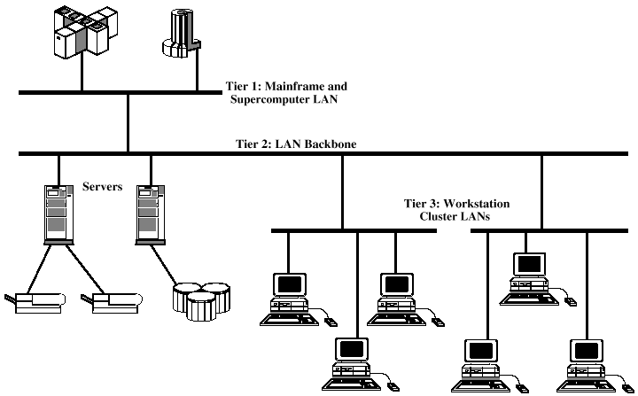
Tiered LAN Diagram

Slide 10
Transmission Medium
Physical path between transmitter and receiver
Guided Media: waves are guided along a solid medium
Unguided Media: waves are transmitted through the atmosphere (wireless transmission)

Slide 11
Transmission Medium Design Factors
Bandwidth
Transmission impairments
Interference
Number of receivers

Slide 12
Twisted Pair Wires
Consists of two insulated copper wires arranged in a regular spiral pattern to minimize the electromagnetic interference between adjacent pairs
Often used at customer facilities and also over distances to carry voice as well as data communications
Low frequency transmission medium

Slide 13
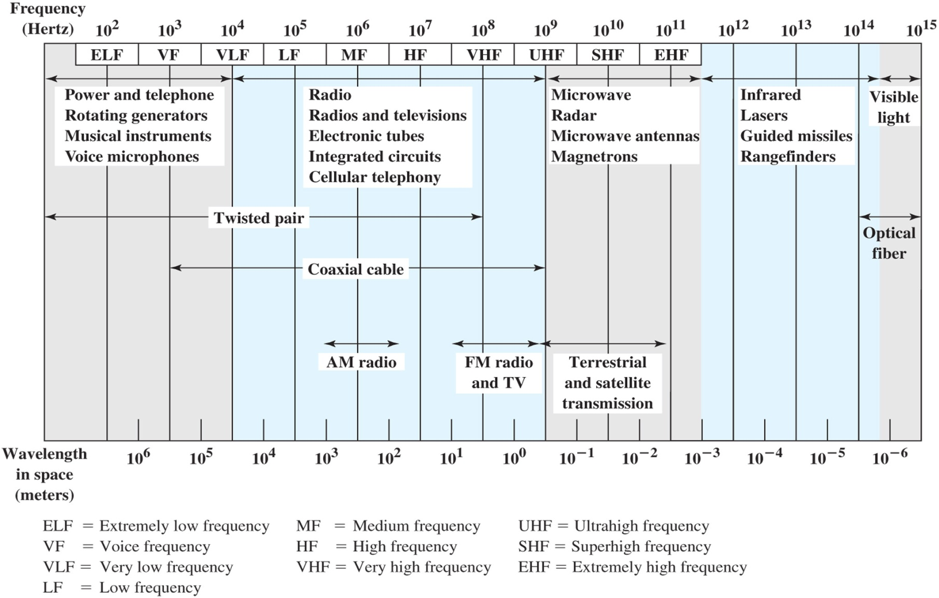
Electromagnetic Spectrum for Telecommunications

Slide 14
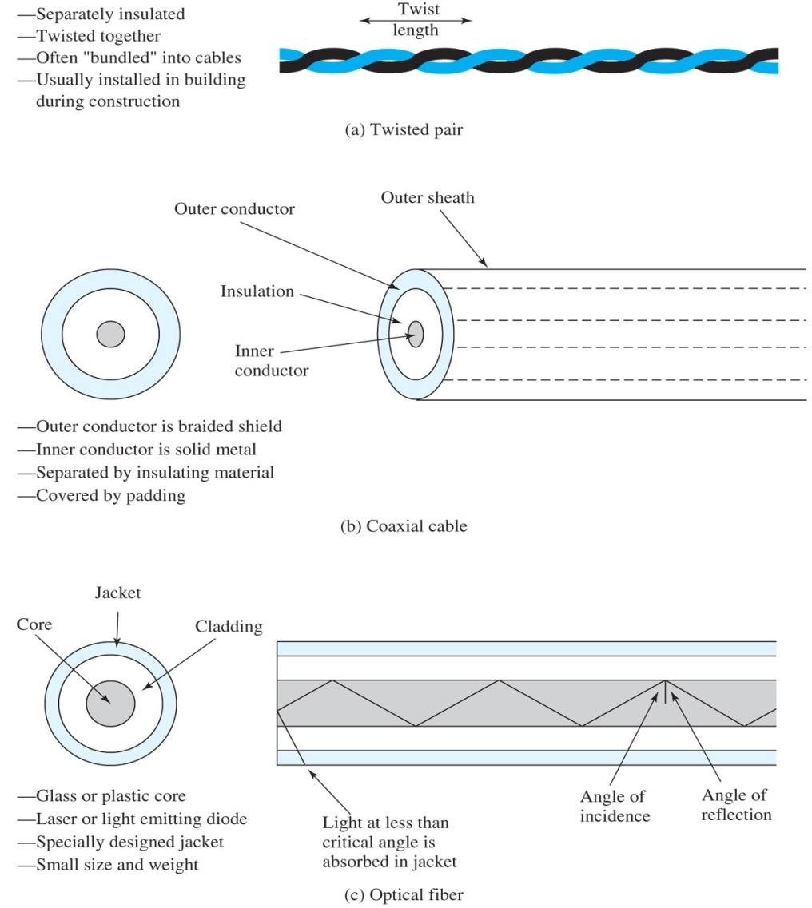
Types of Twisted Pair
STP (shielded twisted pair)
  the pair is wrapped with metallic foil or braid to insulate the pair from electromagnetic interference
UTP (unshielded twisted pair)
  each wire is insulated with plastic wrap, but the pair is encased in an outer covering

Slide 15
Ratings of Twisted Pair
Category 3 UTP
  data rates of up to 16mbps are achievable
Category 5 UTP
  data rates of up to 100mbps are achievable
  more tightly twisted than Category 3 cables
  more expensive, but better performance
STP
  More expensive, harder to work with

Slide 16
Twisted Pair Advantages
Inexpensive and readily available
Flexible and light weight
Easy to work with and install

Slide 17
Twisted Pair Disadvantages
Susceptibility to interference and noise
Attenuation problem
  For analog, repeaters needed every 5-6km
  For digital, repeaters needed every 2-3km
Relatively low bandwidth (3000Hz)

Slide 18
Coaxial Cable (or Coax)
Used for cable television, LANs, telephony
Has an inner conductor surrounded by a braided mesh
Both conductors share a common center axial, hence the term “co-axial”
Traditionally used for LANs, but growth of twisted pair for local nets and optical fiber for larger nets has reduced coax use

Slide 19
Fiber Optic Cable
Thin (2 to 125 µm), flexible medium capable of conducting an optical ray
Advantages
  Greater capacity
  Smaller size/lighter weight
  Lower attenuation
  Electromagnetic isolation
Operate in the range of about 10¹⁴ to 10¹⁵ Hz; (portions of the infrared and visible spectrums)

Slide 20
Fiber Optic Layers
consists of three concentric sections
plastic jacket
glass or plastic
cladding
fiber core

Slide 21
Fiber Optic Types
multimode step-index fiber
  the reflective walls of the fiber move the light pulses to the receiver
multimode graded-index fiber
  acts to refract the light toward the center of the fiber by variations in the density
single mode fiber
  the light is guided down the center of an extremely narrow core

Slide 22
Fiber Optic Signals
fiber optic multimode
step-index
fiber optic multimode
graded-index
fiber optic single mode

Slide 23
Structured Cabling System
Standards for cabling within a building (EIA/TIA-568 and ISO 11801)
Includes cabling for all applications, including LANs, voice, video, etc
Vendor and equipment independent
Designed to encompass entire building, so that equipment can be easily relocated
Provides guidance for pre-installation in new buildings and renovations

Slide 24
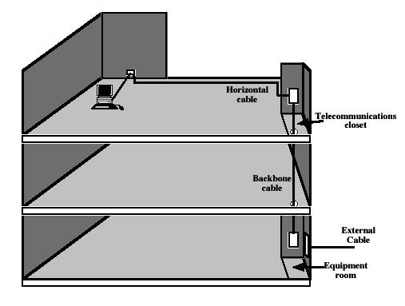
Structured Cabling Elements

Slide 25
LAN Protocol Architecture
Layering of protocols that organize the structure of a LAN
Physical: Medium Access Control (MAC)
Logical: Logical Link Control (LLC)

Slide 26
Advantages of Standards
Assure sufficient volume to keep costs down
Enable equipment from various sources to interconnect

Slide 27
IEEE 802 Reference Model
IEEE 802 committee developed, revises, and extends standards
Use a three-layer protocol hierarchy: physical, medium access control (MAC), and logical link control (LLC)

Slide 28
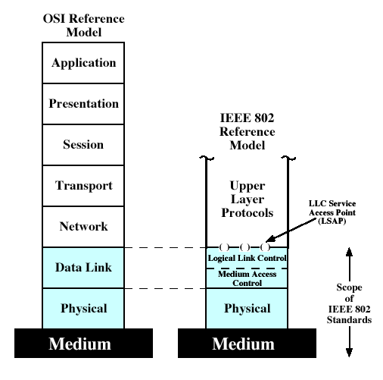
IEEE 802 Protocol Models Compared to OSI Model

Slide 29
Physical Layer
Encoding/decoding of signals and bit transmission/reception
Specification of the transmission medium.
Generally considered "below" the lowest layer of the OSI model. However, the choice of transmission medium is critical in LAN design, and so a specification of the medium is included

Slide 30
Logical Link Control
Specifies method of addressing and controls exchange of data
Independent of topology, medium, and medium access control
Unacknowledged connectionless service (higher layers handle error/flow control, or simple apps)
Connection-mode service (devices without higher-level software)
Acknowledged connectionless service (no prior connection necessary)

Slide 31
Medium Access Control
LLC frames data in a PDU (protocol data unit)
MAC layer frames data again
  MAC control (e.g. priority level)
  Destination MAC address
  Source MAC address
  LLC PDU
  CRC (Cyclic Redundancy Check)

Slide 32
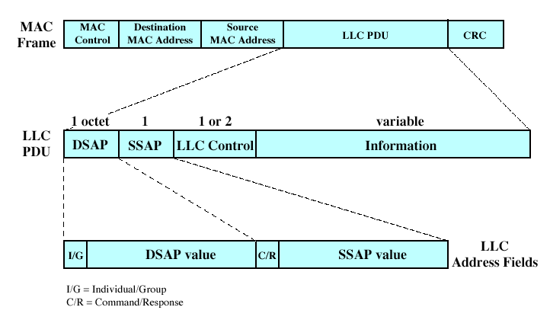
LLC PDU in a MAC Frame

